Slide 1
Guillermo Presa
Update 10
Long update
Importing geometry
Variable lattice density
Lattice and robot models
Path planning
Implementation and demo

Slide 2
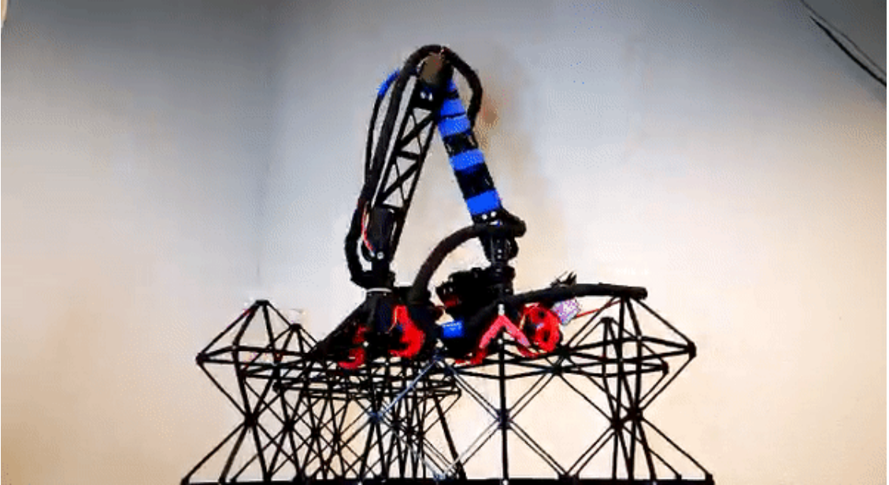
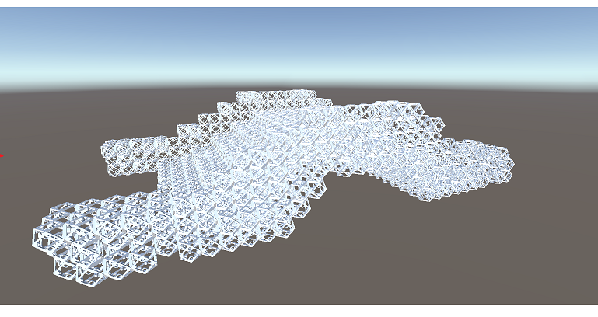
Automated lattice assembly
Lattice walking robot places lattices to conform a structure
09-10-2020

Slide 3
Geometry definition.
Discretizing model into lattice structure

Slide 4
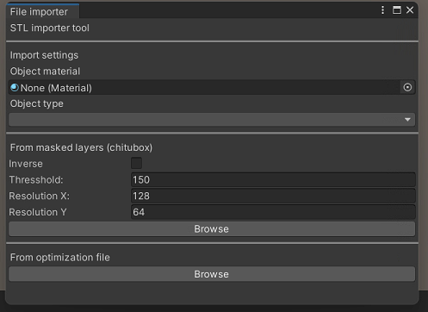
Build geometry definition
Import geometry from different sources:
STL/ 3D model route
Space time top-opt route
09-10-2020

Slide 5
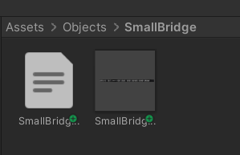
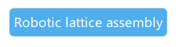
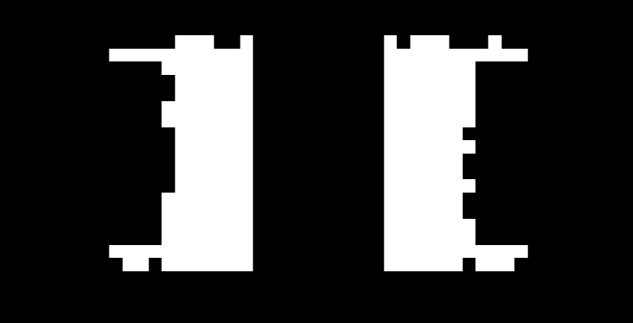
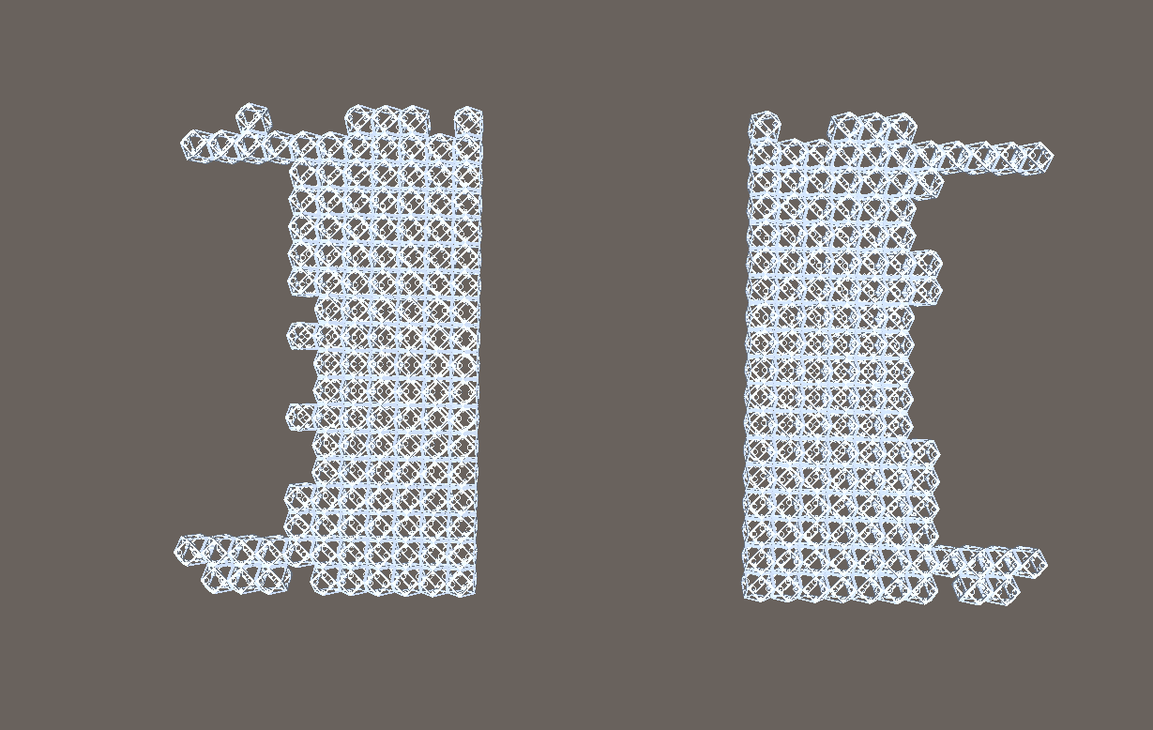

STL discretization. The easy way
Slice STL in a DLP slicer.
Model converted to collection of masks.
Pixel = voxel
Image = layer
Unity reads the image collection and parses into a proprietary format
(json collection of objects)
09-10-2020

Slide 6
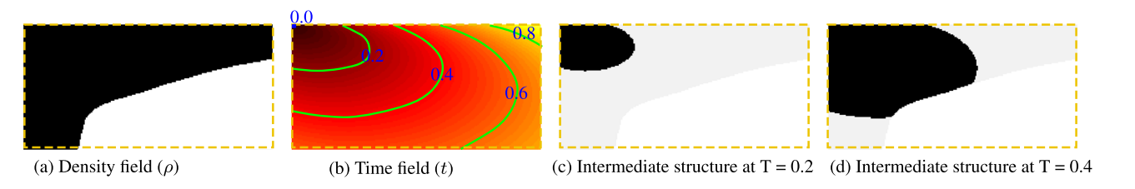
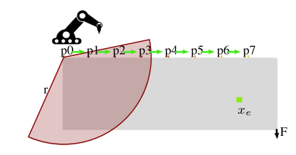
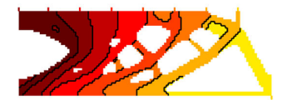
Space time topology optimization [WIP]
Can also be converted into a
(json collection of objects)
where each object now gets a timestep according to the time field
09-10-2020

Slide 7
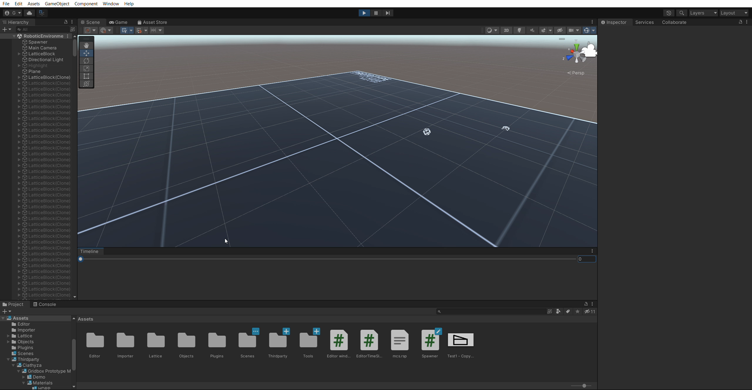
Lattices have an order
09-10-2020

Slide 8
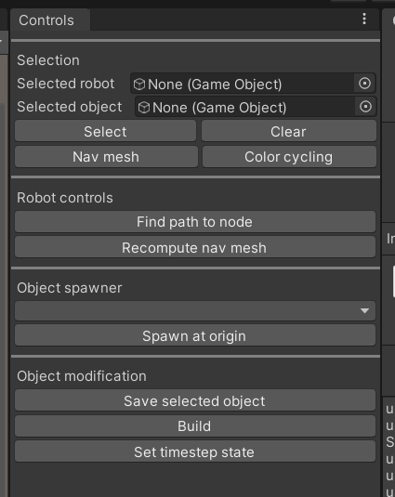
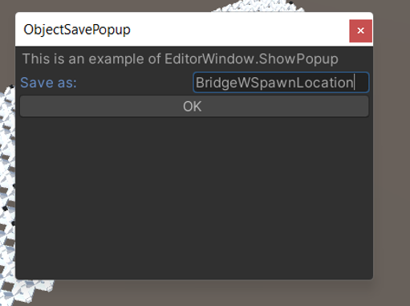
Object saver
09-10-2020

Slide 9
Variable lattice density

Slide 10
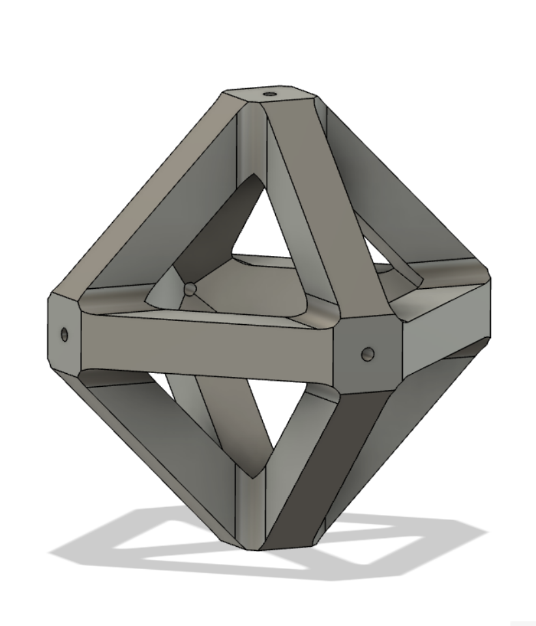
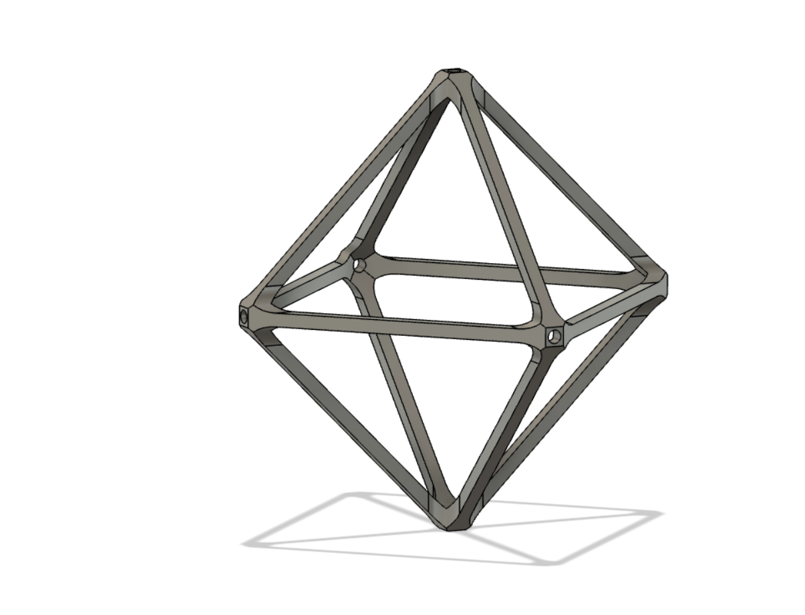
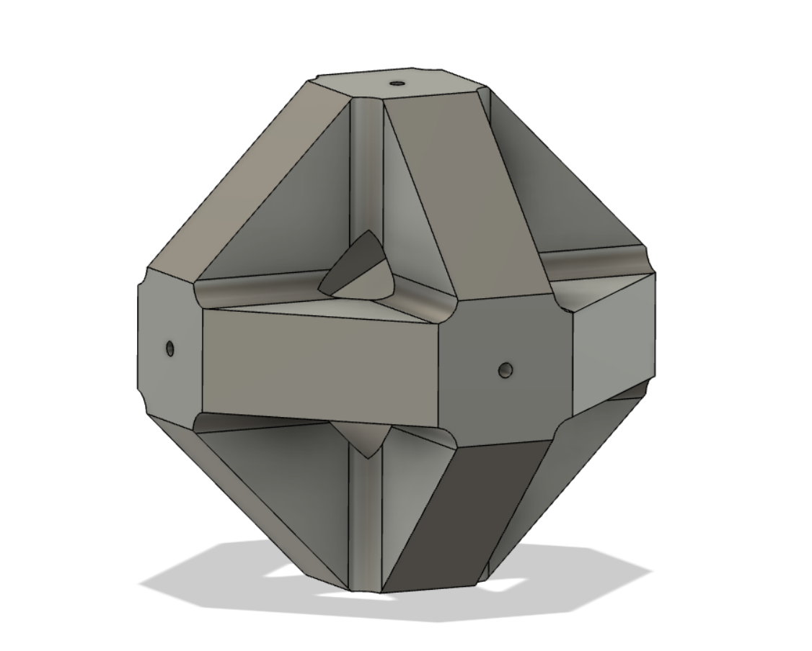
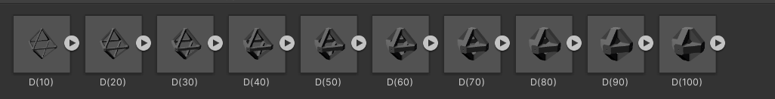
Variable lattice density
09-10-2020

Slide 11

Variable lattice density
Downscale: Generate higher resolution images and interpolate from a neighborhood of points.
Grayscale: Or feed images made in grayscale (from topopt or else)
09-10-2020

Slide 12
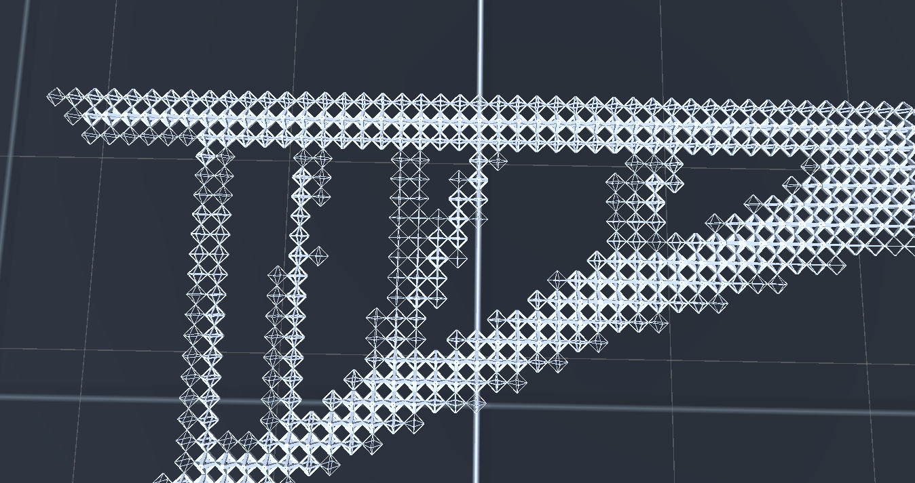
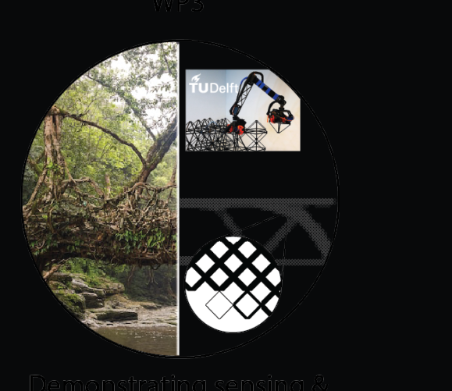
Multi lattice density
Variable lattice density visualization
09-10-2020

Slide 13
Lattice and robot models

Slide 14
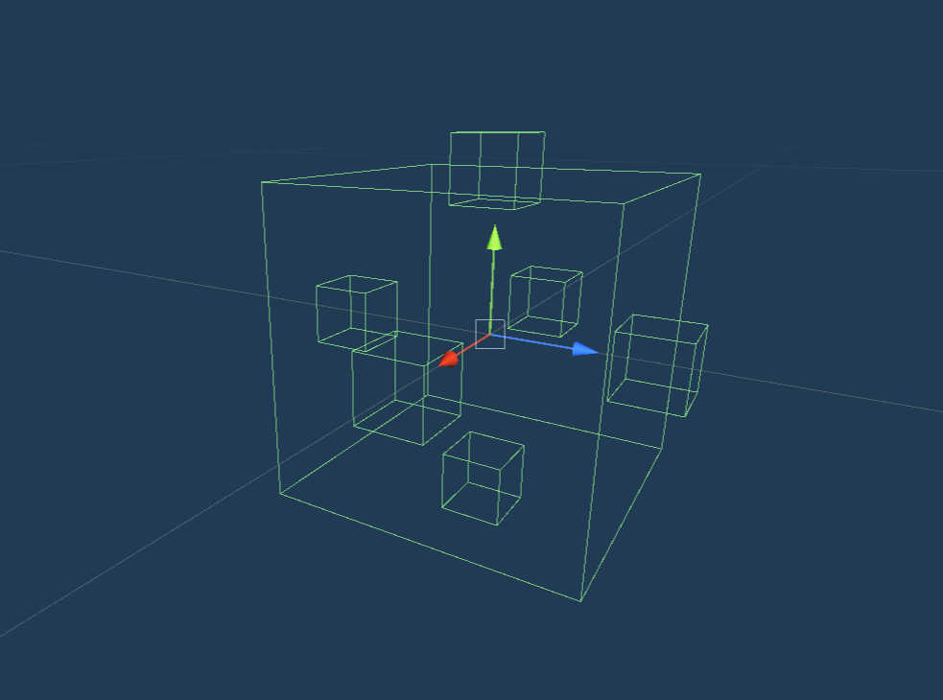
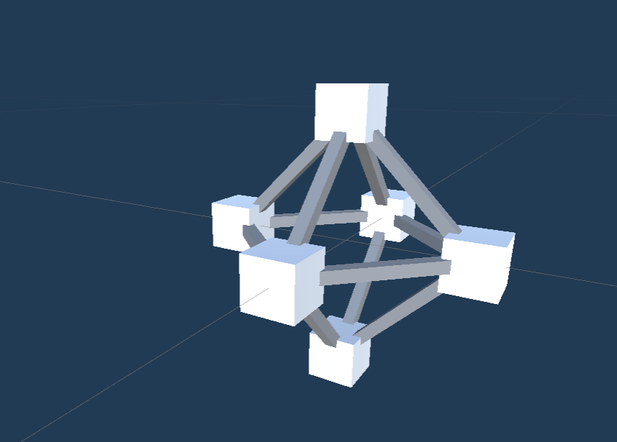
What is a lattice?
Model
Mechanics
Colliders
(can detect collisions)
A lattice is a collection of nodes rigidly attached that can interlock with other nodes
09-10-2020

Slide 15
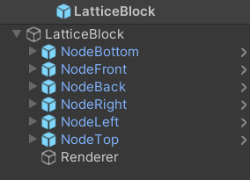
Architecture of a lattice.
The lattice Parent holds information. What are its nodes, is the lattice placed already, the lattice density…
The nodes contain a collider and are constantly checking for other nodes within their reach, as well as mouse interactions… They update the parent.
Renderer just displays a 3D model
09-10-2020

Slide 16
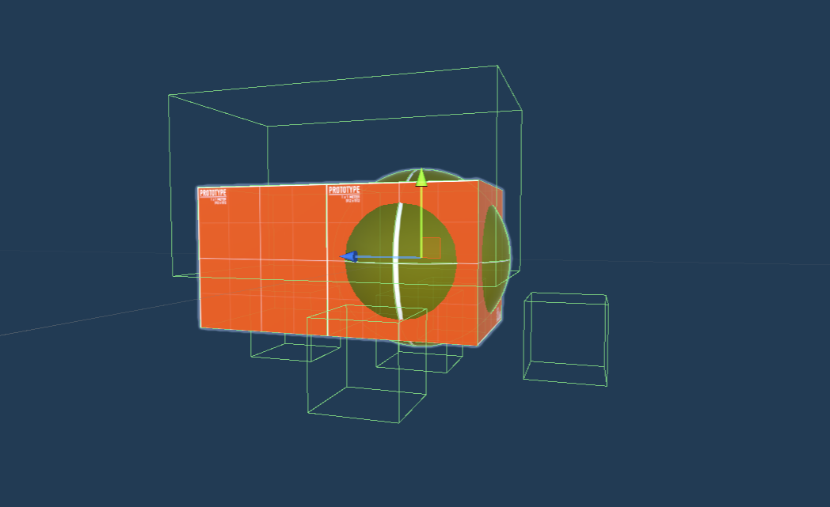
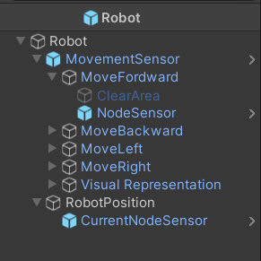
Robot – very similar to a lattice
The robot contains a movement sensor.
It’s a collection of node sensors, virtual nodes the robot uses to evaluate the presence of lattice nodes.
09-10-2020

Slide 17
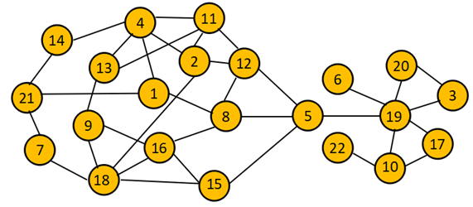
Path finding
First build a graph or tree with all the possible robot movements between nodes.
Movement
Nodes
09-10-2020

Slide 18
Building a navigation graph
Recursive problem
From its initial position the robot evaluates all possible movements using the node sensors. If a movement is possible add the two nodes onto the graph and link them. Repeat recursively from those new positions.
The graph built is directional and the edge weights are set depending on the movement performed (not accurate)
Finding the shortest path in this type of graph is a very traditional problem
09-10-2020

Slide 19
This is not accurate
The robot is not on a node.
Its on more than one node. Its on a node with a certain state (direction).
Usually, you are not on two street intersections at the same time
Not very traditional path planning problem. Not going there quite yet. Simpler works for now, just not as efficient
09-10-2020

Slide 20
Demo

Slide 21
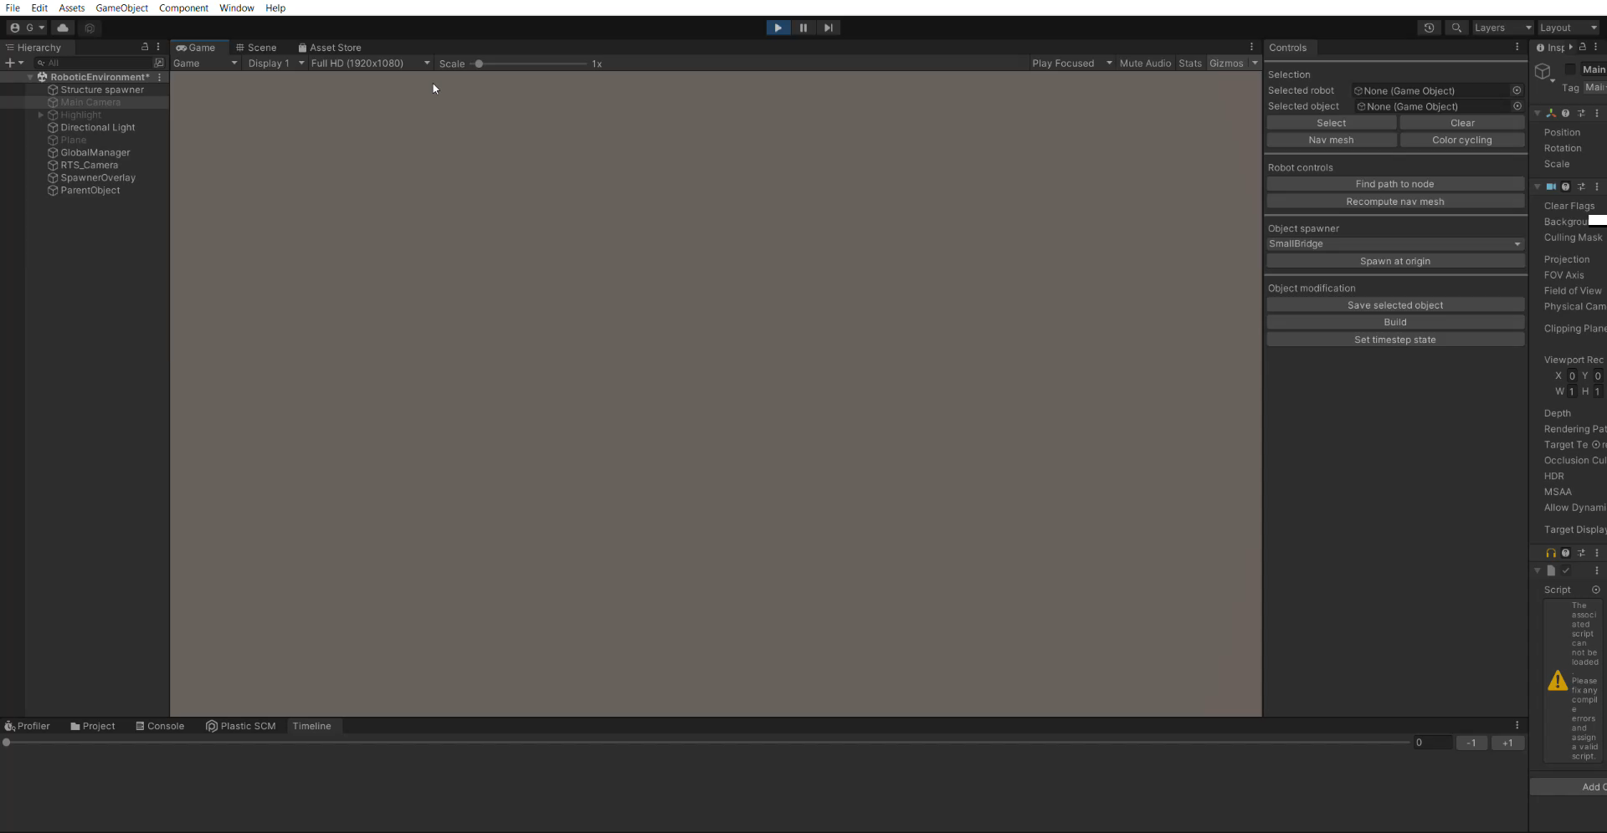
09-10-2020

Slide 22
Why unity?

Slide 23
3 factors
Code: Python, C#, C++, assembly. What is the appropriate level of abstraction. Additionally which tools provide 3D transformations. Collisions, etc..
User interface: Python is a PIA. Unity and WinForm C# programs are both great at this. WinForm a bit easier.
3D visualization: Its an amazing tool for this
09-10-2020

Slide 24
Closing points

Slide 25
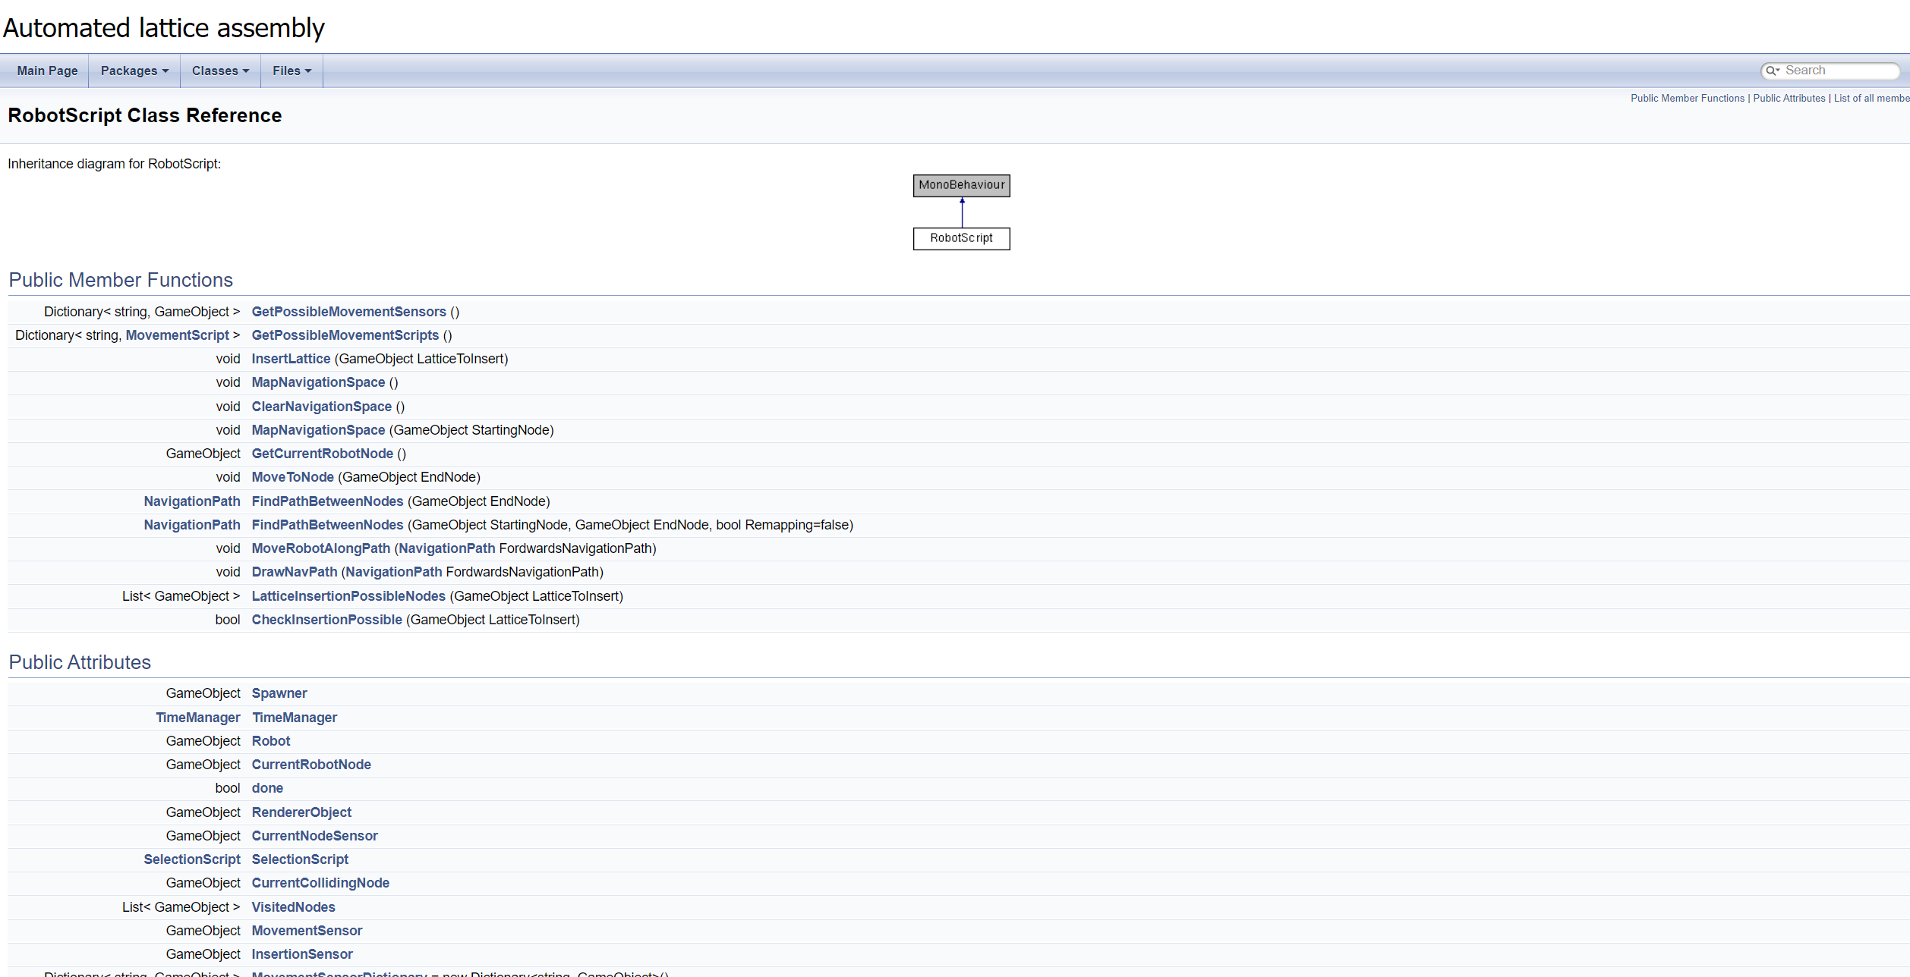
Next up: Debug, document, literature
09-10-2020

Slide 26
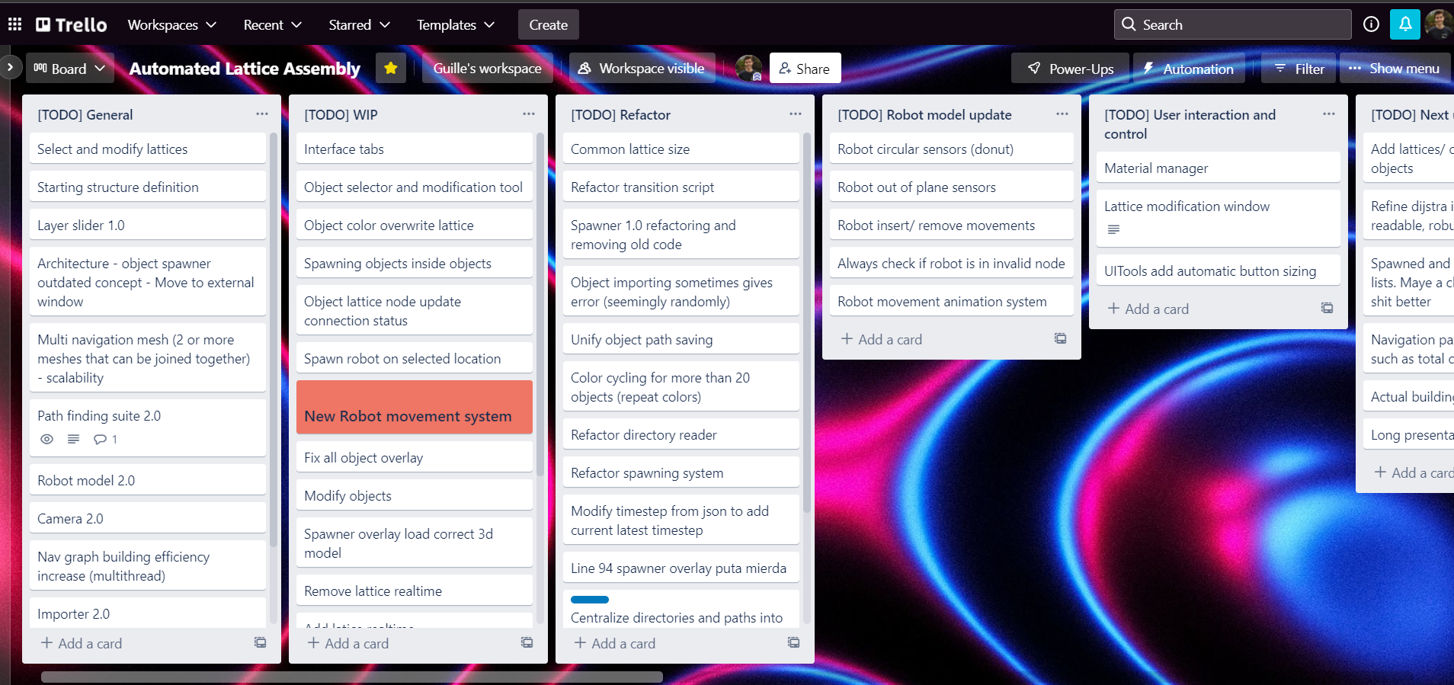
Suggestions
Open to suggestions on new features or things that could be improved. Looking to fill the Trello some more ☺
09-10-2020

Slide 27
Bedankt!
Guillermo Presa

